Slide 1

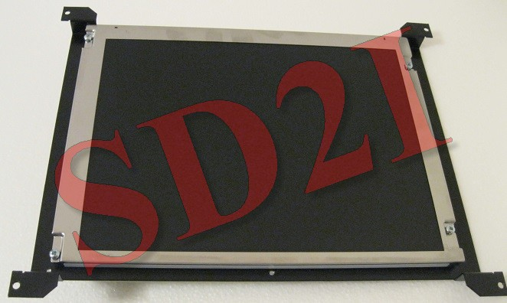
Specification
CNC-
ENGCC100-
104
Technical specification :
Power supply input
12 Vdc
Power consumption
36W maximum
Frequency range
15kHz-60kHz horizontal –
50-80 Hz vertical
Input signals
TTL LVDS
100 Ohm
Synchronization
TTL LVDS
Input connector
DB25F
Operating conditions
Temperature : 0°C +50°C
Humidity : 10% 80%
Resolution
800X600
Brightness
400Cd
Contrast
700 : 1
Dot pitch
0.264mm
Response time
35mS
Viewving angle
160/140 R-L/U-D
S.D.2I – Tél : 01 69 52 28 60 – Fax : 09 71 70 60 12 – email : sd2i@orange.fr – Web : solutiondeveloppement.com
23 Bld DUMAY DELILLE – 91230 MONTGERON
NII FR21 4910009056 – SIRET 491000905600012 – APE : 7112B

